Slide 1
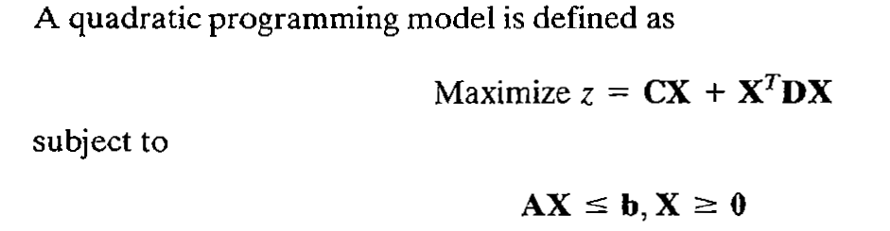
Quadratic Programming Problem
A quadratic programming problem Optimizes a quadratic function of n variables subject to m linear inequality or equality constraints.
In compact notation,
Assume that the matrix D is symmetric and negative definite. This means that
Z is strictly concave. The constraints are linear, which guarantees a convex solution
Space.

Slide 2
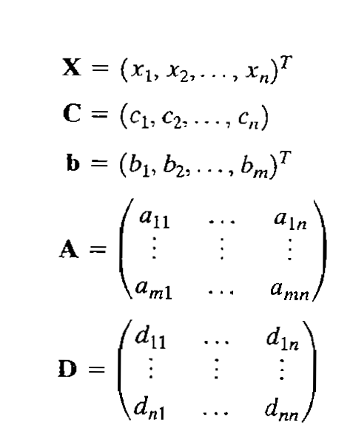
where

Slide 3
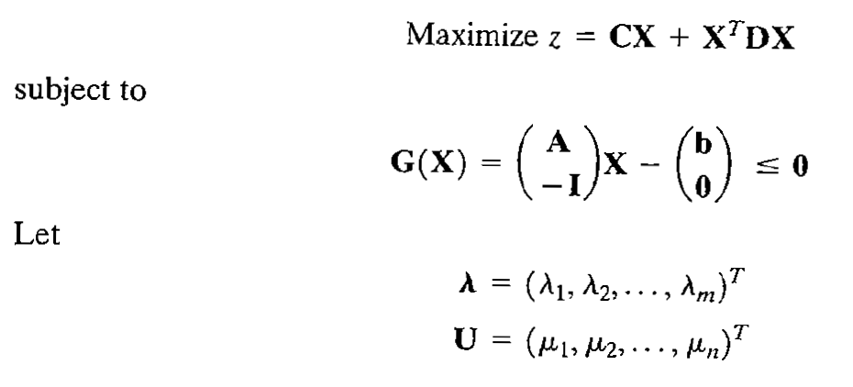
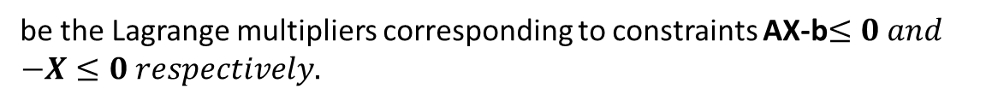
Consider the non-negativity restrictions on the decision variables as explicit constraints
The above quadratic programming problem can be written as
be the Lagrange multipliers corresponding to constraints AX-b$≤0 and$
$$−X≤0 respectively.$$

Slide 4
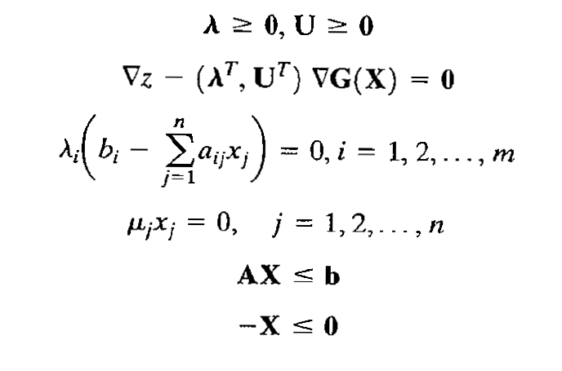
The Kuhn-Tucker conditions of the above Quadratic Programming Problem are:

Slide 5
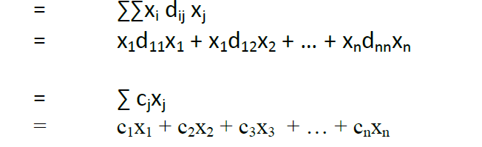
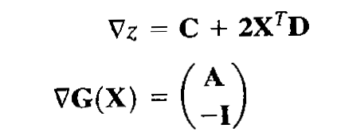

Define :
$X^{T}$DX
CX
+ ………………………………………………………………….
We know that
(since D is a symmetric matrix)
and

Slide 6
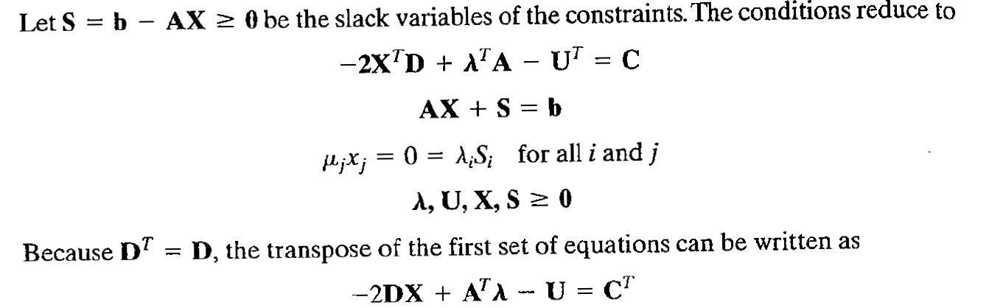
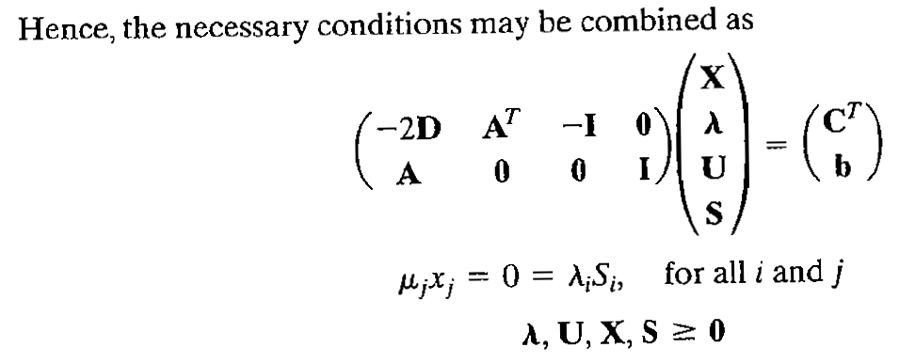
Where I is the identity matrix

Slide 7
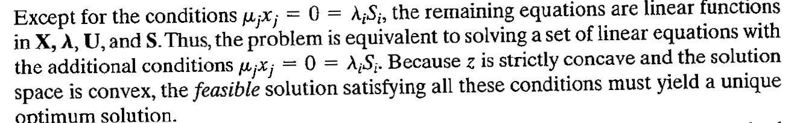

Remark:
The conditions
are called the complementary slackness conditions

Slide 8
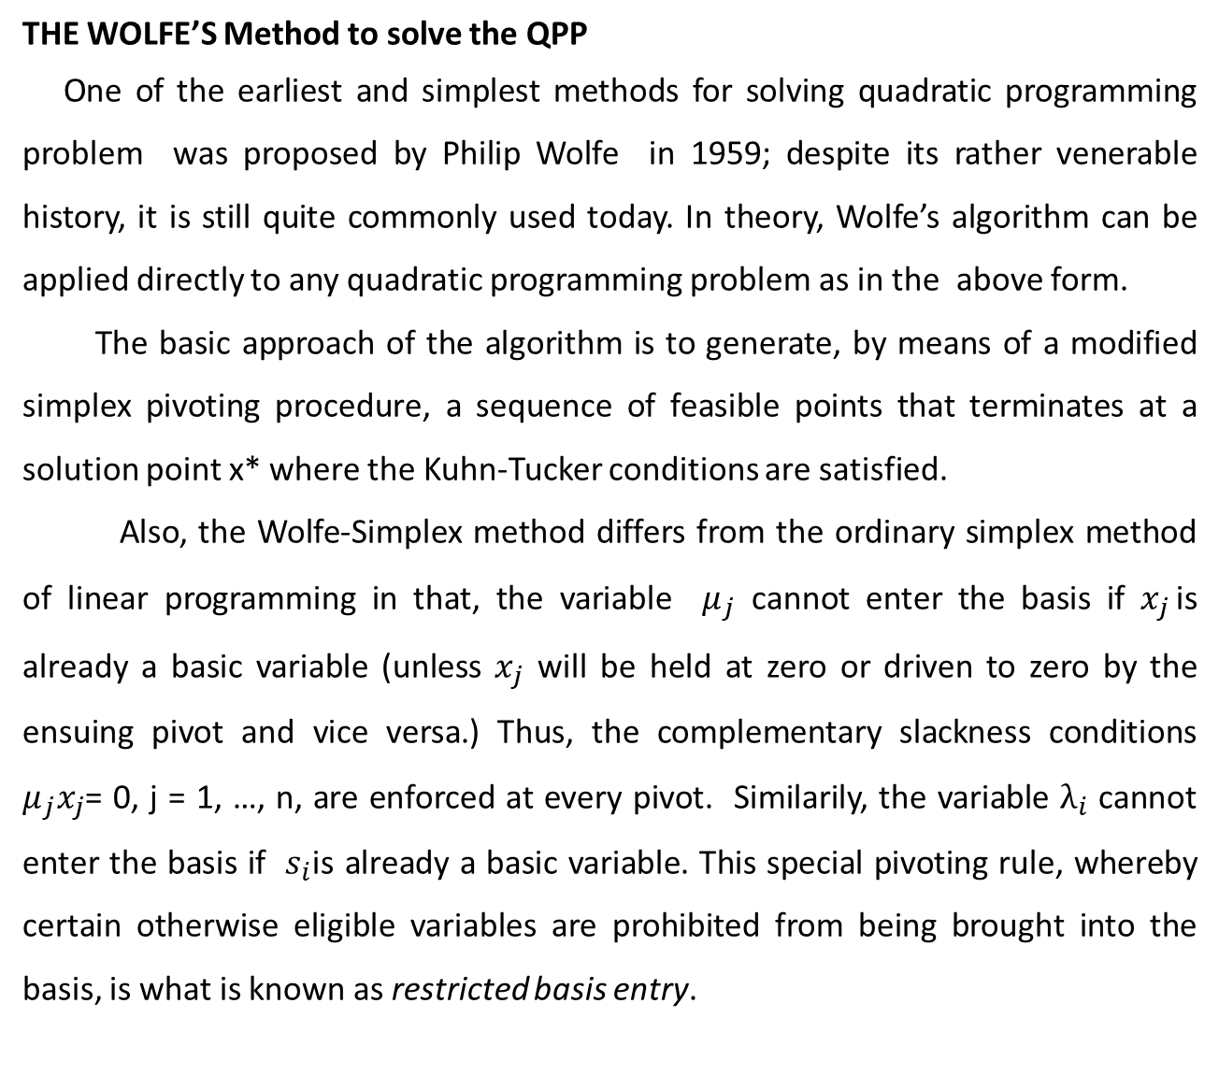
THE WOLFE’S Method to solve the QPP
One of the earliest and simplest methods for solving quadratic programming problem was proposed by Philip Wolfe in 1959; despite its rather venerable history, it is still quite commonly used today. In theory, Wolfe’s algorithm can be applied directly to any quadratic programming problem as in the above form.
The basic approach of the algorithm is to generate, by means of a modified simplex pivoting procedure, a sequence of feasible points that terminates at a solution point x* where the Kuhn-Tucker conditions are satisfied.
Also, the Wolfe-Simplex method differs from the ordinary simplex method of linear programming in that, the variable $μ_{j}$ cannot enter the basis if $x_{j }$is already a basic variable (unless $x_{j}$ will be held at zero or driven to zero by the ensuing pivot and vice versa.) Thus, the complementary slackness conditions $μ_{j}x_{j}$= 0, j = 1, …, n, are enforced at every pivot. Similarily, the variable $λ_{i}$ cannot enter the basis if $s_{i}$is already a basic variable. This special pivoting rule, whereby certain otherwise eligible variables are prohibited from being brought into the basis, is what is known as restricted basis entry.

Slide 9
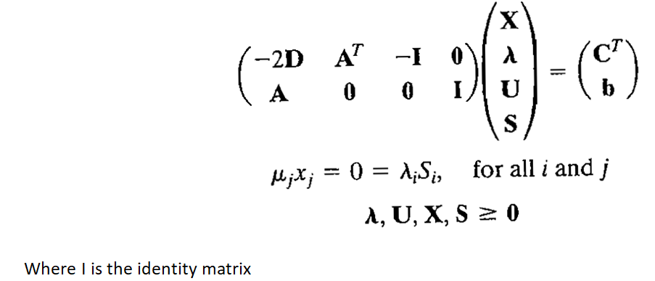
Steps of the Wolfe’s Method to solve the QPP
Step1 : Write the K-T necessary conditions for the given QPP in the following form:

Slide 10
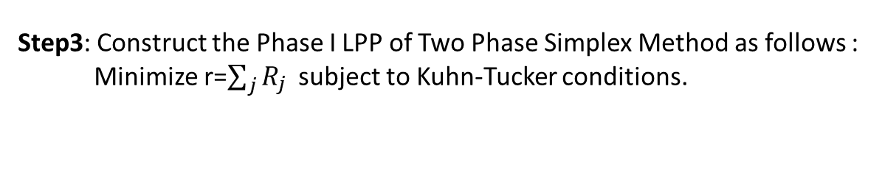
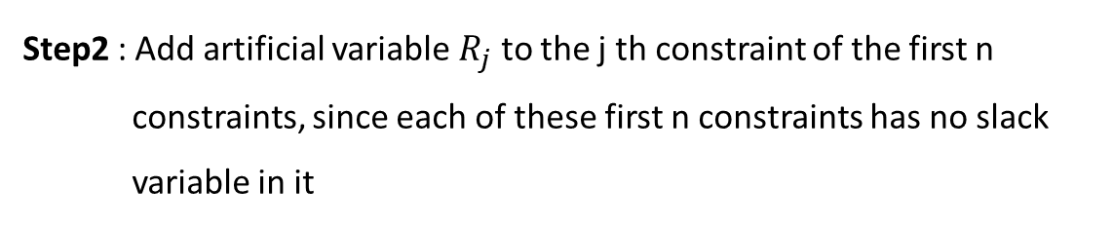
Step2 : Add artificial variable $R_{j}$ to the j th constraint of the first n
constraints, since each of these first n constraints has no slack
variable in it
Step3: Construct the Phase I LPP of Two Phase Simplex Method as follows :
Minimize r=$\sum_{j}{R_{j }}$ subject to Kuhn-Tucker conditions.
Step4 : Rewrite the objective function in terms of non basic variables by
using the first n constraint equations of LPP and Form the simplex table
Step5 : Obtain the feasible solution of the quadratic Programming
problem by using the simplex method optimality and
feasibility Conditions along with complementary slackness
conditions.

Slide 11
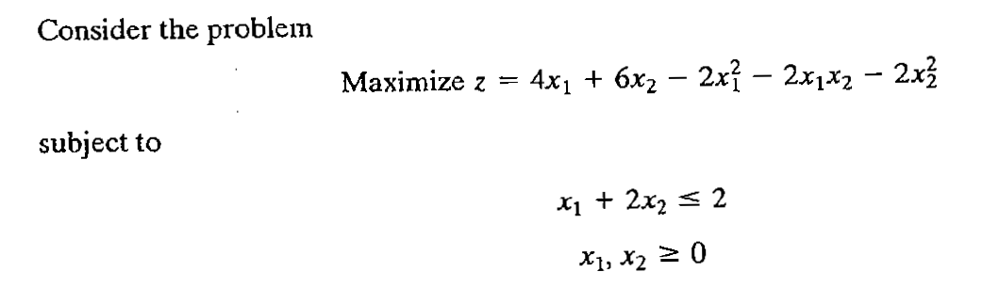
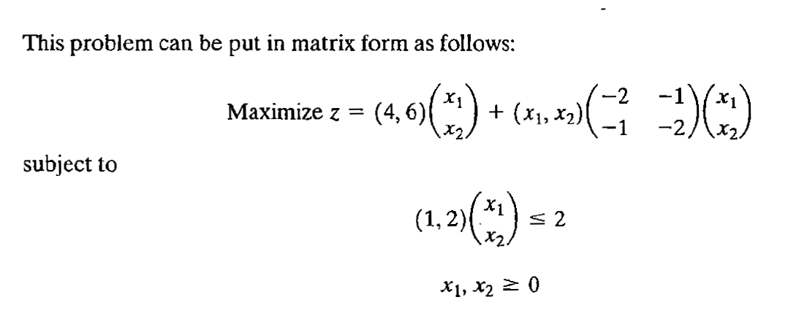
Example :

Slide 12
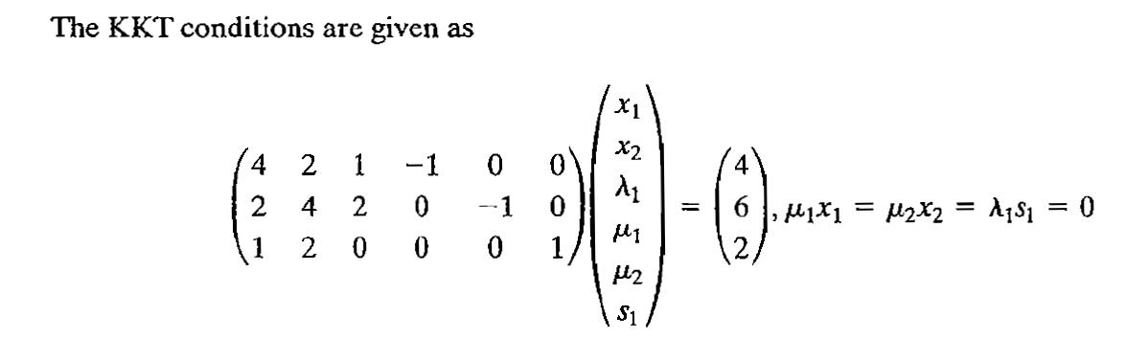

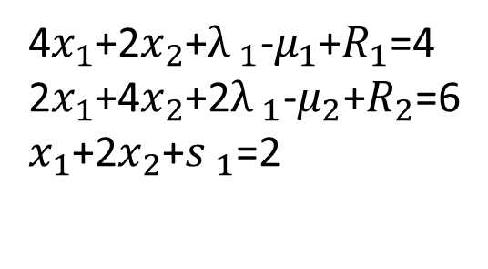
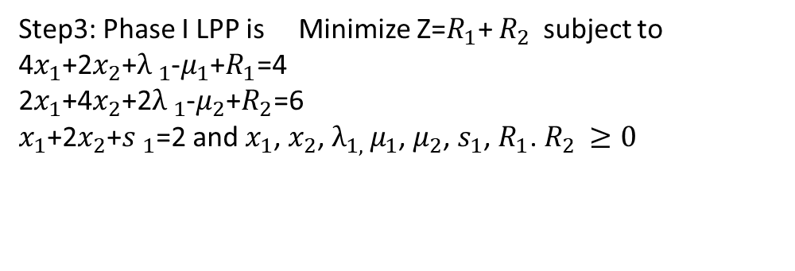

Step1:
Step2:
4$x_{1}$+2$x_{2}$+${λ }_{1}$-$μ_{1}$+$R_{1}$=4
2$x_{1}$+4$x_{2}$+2${λ }_{1}$-$μ_{2}$+$R_{2}$=6
$x_{1}$+2$x_{2}$+${s }_{1}$=2
and $x_{1}$, $x_{2}$, $λ_{1, }μ_{1}$, $μ_{2}$, $s_{1}$, $R_{1}$. $R_{2 }≥0$
Step3: Phase I LPP is Minimize Z=$R_{1}$+ $R_{2 }$ subject to 4$x_{1}$+2$x_{2}$+${λ }_{1}$-$μ_{1}$+$R_{1}$=4
2$x_{1}$+4$x_{2}$+2${λ }_{1}$-$μ_{2}$+$R_{2}$=6
$x_{1}$+2$x_{2}$+${s }_{1}$=2 and $x_{1}$, $x_{2}$, $λ_{1, }μ_{1}$, $μ_{2}$, $s_{1}$, $R_{1}$. $R_{2 }≥0$

Slide 13
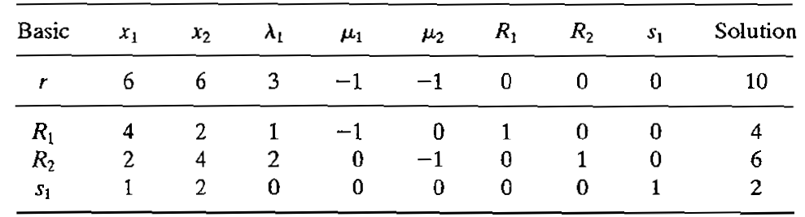
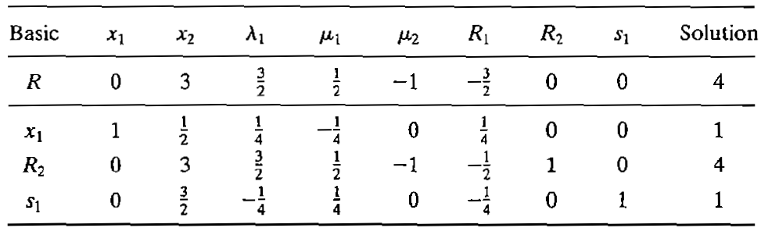
Step4 :
Step5:
Entering variable :$x_{1 }$(since $μ_{1 }$is not in basic)and Leaving variable :$R_{1}$ Pivot No. 4
This table is not optimal. $x_{2}$ enters (since $μ_{2 }$is not in basic)and $s_{1}$ leaves Pivot element:3/2

Slide 14
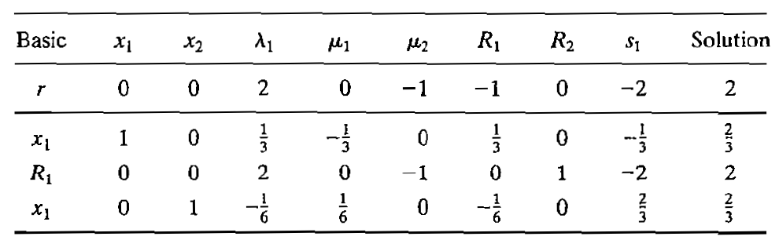
This table is not optimal. Since $s_{1}$ is not in basic, $λ_{1}$ enters , $R_{1}$ leaves, P.E=2

Slide 15
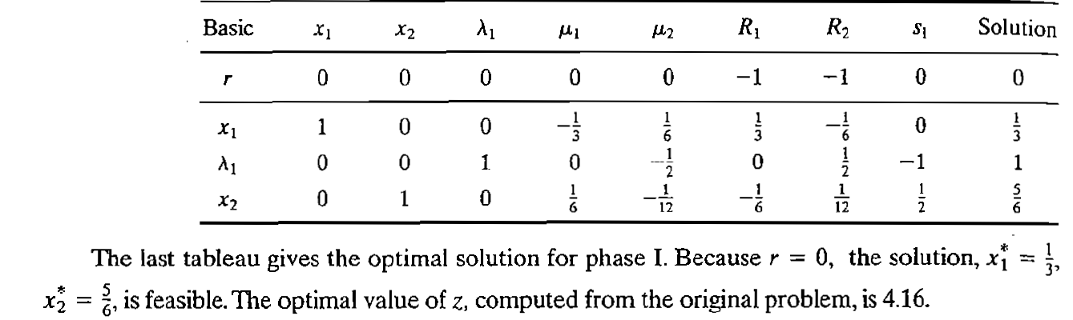

Slide 16
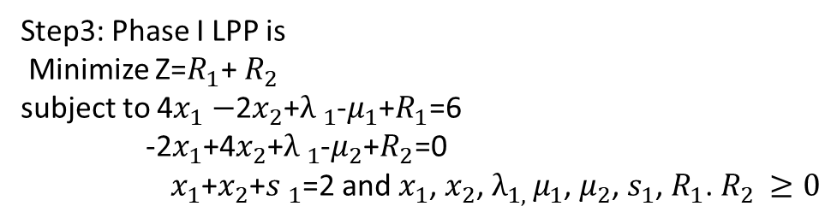
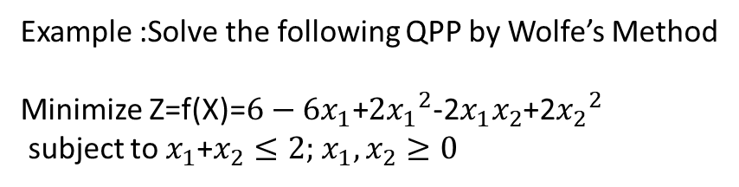
Example :Solve the following QPP by Wolfe’s Method
Minimize Z=f(X)=$6−6x_{1}$+$2{x_{1}}^{2}$-2$x_{1}x_{2}$+2${x_{2}}^{2}$
subject to $x_{1}$+$x_{2}≤2;$ $x_{1}, x_{2}≥0$
Step3: Phase I LPP is
Minimize Z=$R_{1}$+ $R_{2 }$
subject to 4$x_{1}−$2$x_{2}$+${λ }_{1}$-$μ_{1}$+$R_{1}$=6
-2$x_{1}$+4$x_{2}$+${λ }_{1}$-$μ_{2}$+$R_{2}$=0
${ x}_{1}$+$x_{2}$+${s }_{1}$=2 and $x_{1}$, $x_{2}$, $λ_{1, }μ_{1}$, $μ_{2}$, $s_{1}$, $R_{1}$. $R_{2 }≥0$
Solution of the QPP is :$x_{1}$=3/2 , $x_{2}$=1/2 with minimum Z=1/2

Slide 17
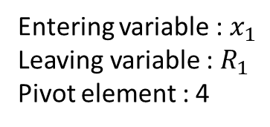
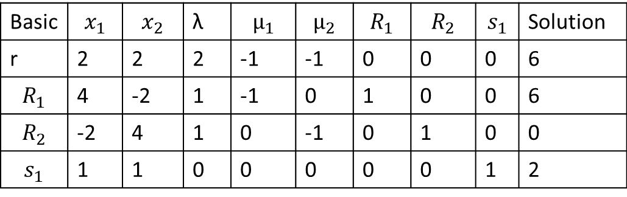
Basic | $$x_{1}$$ | $$x_{2}$$ | λ | $$μ_{1}$$ | $$μ_{2}$$ | $$R_{1}$$ | $$R_{2}$$ | $$s_{1}$$ | Solution
r | 2 | 2 | 2 | -1 | -1 | 0 | 0 | 0 | 6
$$R_{1}$$ | 4 | -2 | 1 | -1 | 0 | 1 | 0 | 0 | 6
$$R_{2}$$ | -2 | 4 | 1 | 0 | -1 | 0 | 1 | 0 | 0
$$s_{1}$$ | 1 | 1 | 0 | 0 | 0 | 0 | 0 | 1 | 2
Entering variable : $x_{1}$
Leaving variable : $R_{1}$
Pivot element : 4

Slide 18
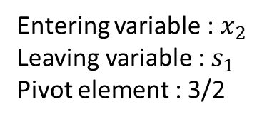
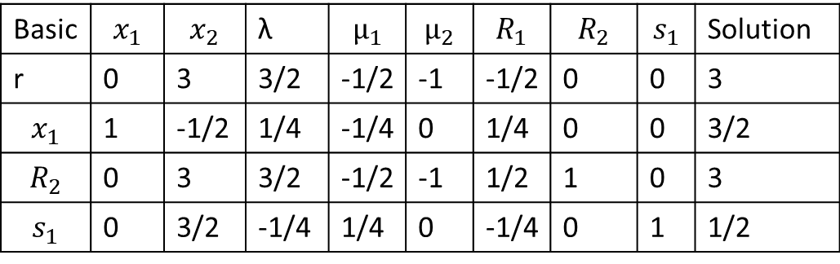
Basic | $$x_{1}$$ | $$x_{2}$$ | λ | $$μ_{1}$$ | $$μ_{2}$$ | $$R_{1}$$ | $$R_{2}$$ | $$s_{1}$$ | Solution
r | 0 | 3 | 3/2 | -1/2 | -1 | -1/2 | 0 | 0 | 3
$$x_{1}$$ | 1 | -1/2 | 1/4 | -1/4 | 0 | 1/4 | 0 | 0 | 3/2
$$R_{2}$$ | 0 | 3 | 3/2 | -1/2 | -1 | 1/2 | 1 | 0 | 3
$$s_{1}$$ | 0 | 3/2 | -1/4 | 1/4 | 0 | -1/4 | 0 | 1 | 1/2
Entering variable : $x_{2}$
Leaving variable : $s_{1}$
Pivot element : 3/2

Slide 19
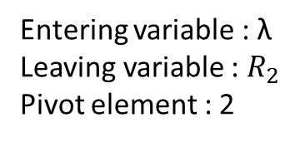
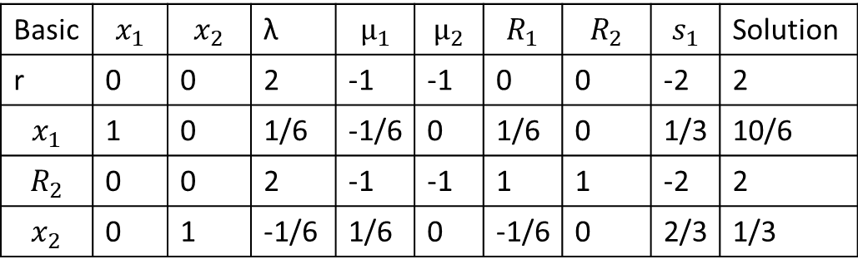
Basic | $$x_{1}$$ | $$x_{2}$$ | λ | $$μ_{1}$$ | $$μ_{2}$$ | $$R_{1}$$ | $$R_{2}$$ | $$s_{1}$$ | Solution
r | 0 | 0 | 2 | -1 | -1 | 0 | 0 | -2 | 2
$$x_{1}$$ | 1 | 0 | 1/6 | -1/6 | 0 | 1/6 | 0 | 1/3 | 10/6
$$R_{2}$$ | 0 | 0 | 2 | -1 | -1 | 1 | 1 | -2 | 2
$$x_{2}$$ | 0 | 1 | -1/6 | 1/6 | 0 | -1/6 | 0 | 2/3 | 1/3
Entering variable : λ
Leaving variable : $R_{2}$
Pivot element : 2

Slide 20
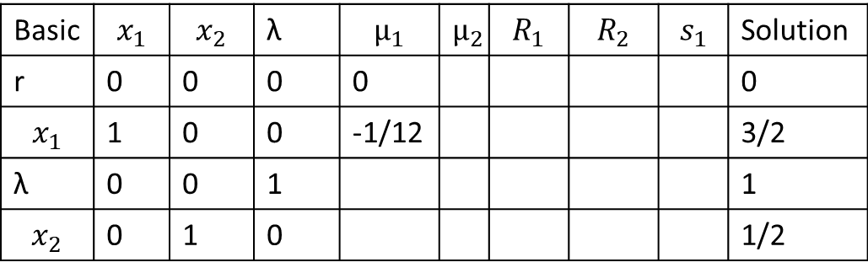
Basic | $$x_{1}$$ | $$x_{2}$$ | λ | $$μ_{1}$$ | $$μ_{2}$$ | $$R_{1}$$ | $$R_{2}$$ | $$s_{1}$$ | Solution
r | 0 | 0 | 0 | 0 |  |  |  |  | 0
$$x_{1}$$ | 1 | 0 | 0 | -1/12 |  |  |  |  | 3/2
λ | 0 | 0 | 1 |  |  |  |  |  | 1
$$x_{2}$$ | 0 | 1 | 0 |  |  |  |  |  | 1/2

Slide 21
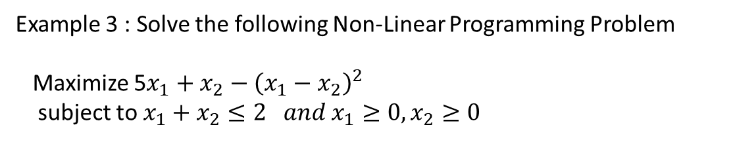
Example 3 : Solve the following Non-Linear Programming Problem
Maximize 5$x_{1}+x_{2}−{\left(x_{1}−x_{2}\right)}^{2}$
subject to $x_{1}+x_{2}≤2 and x_{1}≥0, x_{2}≥0$

